Slide 1


Project Guide Dr. K.Kumar M.E., Ph.D., Associate Professor
ONLINE EXAM MONITORING SYSTEM
TEAM MEMBERS
Divya A(1817116)
Hafeeza Begum M (1817118)
Keerthana K(1817123)
Pavithra T(1817137)

Slide 2
PROBLEM STATEMENT
With the expansion of e-learning, exam monitoring becomes more difficult. Therefore, real-time monitoring is necessary to ensure the student's identity continuously throughout the examination period
PROPOSED SOLUTION
Design of face detection and recognition system to monitor students during online examinations
Step 1 : Student Verification
Step 2 : Monitor students during examination
SOLUTION (Step 1):
Student verification done using face detection and face recognition .
Face detection -> Identify the face present in the image .
Face Recognition -> Way of confirming the student identity using their face .
SOLUTION (Step 2):
Create an automated proctoring system where the user can be monitored automatically through the webcam . Monitoring the user’s eye movement , mobile phone usage detection , identify the presence of person other than user.

Slide 3


Verification Process
Monitoring Process
Face Detection
Eye Tracking
Person counting
Face Recognition
Mobile phone detection

Slide 4
Why MTCNN ?
Algorithms | Drawbacks
Haar Cascade | Do not provide best accuracy.
DNN Face Detector | Does not detect small faces as it is trained for minimum face size of 80×80.
Dlib Frontal Face Detector | Does not fit for non frontal facing faces .

Slide 5
MTCNN Algorithm
MTCNN - Multitask Cascaded Convolutional Neural Networks
It detects faces and facial landmarks on images.
Advantages over other Algorithms
Speed – Prediction step takes around 0.005 secs for 11.5 FPS
Accurate - It should only detect faces (no false positives) and detect all faces (no false negatives)
Robust - Faces should be detected in different poses, rotation, lighting conditions .
Utilizing all available resources - using GPU if possible, using color (RGB) input etc.

Slide 6
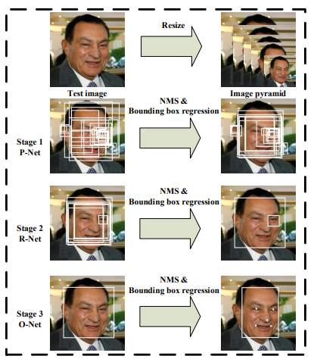
MTCNN Architecture
It takes the image and resize it to different scales inorder to build an image pyramid which is input to the three Staged cascading network.
Three convolution networks:
1.P-NET ( Proposal network )
2.R-NET ( Refine network )
3.O-NET (Output network )
Application:
SELF-Driving cars : This algorithm is used to identify the objects present in front of the moving car by using R-Net it shows the Identified object in the bounding box .

Slide 7
Work Flow of Face Detection
Input Image
Detected image with Bounding box and
Facial Points
MTCNN Algorithm
Bounding Box Creation
Facial Landmarks Detection

Slide 8

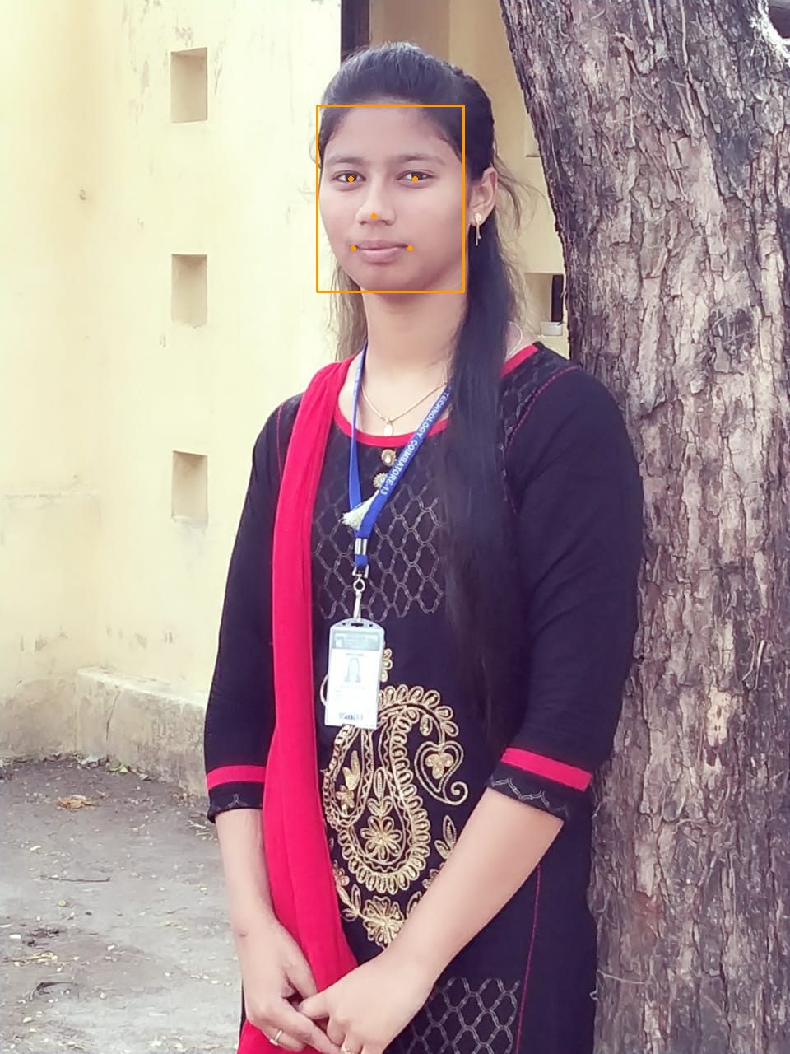
Face Detection Implementation
Input Image
Face Detected Image
Bounding Box
5 Facial key points

Slide 9
Work Flow of Face Verification
Input Image
MTCNN Algorithm
Feature Extraction
Yes
No
Image Comparison using
Cosine similarity
(Value <=0.5)
Face
Not Matched
Face Matched
Face Verification done
Stop

Slide 10
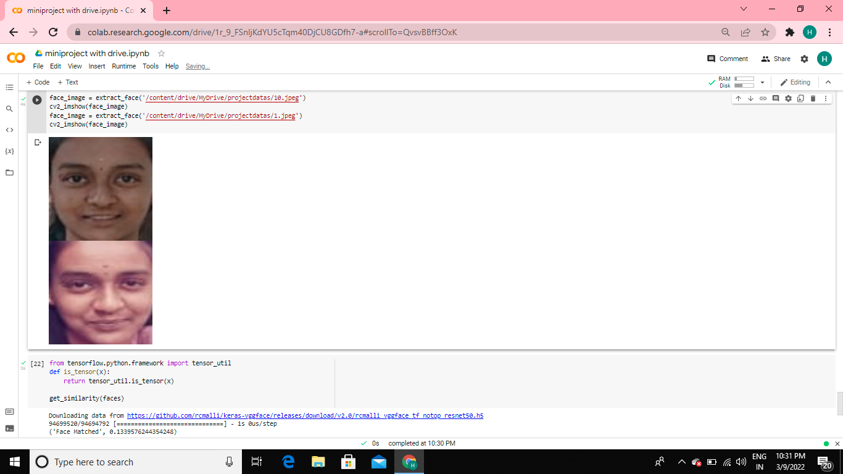

Face Verification Implementation
Face Matched
Face Not Matched

Slide 11
Work Flow of Eye Tracking
Input frame
RGB to Grey Scale Conversion
Eye Detection
Eye Edge Detection
Found ?
NO
YES
Draw Eye Region
Save Eye Central Point
Stop

Slide 12
Work Flow of Object Detection
Input frame
Bounding Box
Objectness Score >0.5 ?
NO
Ignore the Bounding Boxes
YES
Apply Non Maximum supression
Output image with object detection
Identify the class confidence
Stop

Slide 13
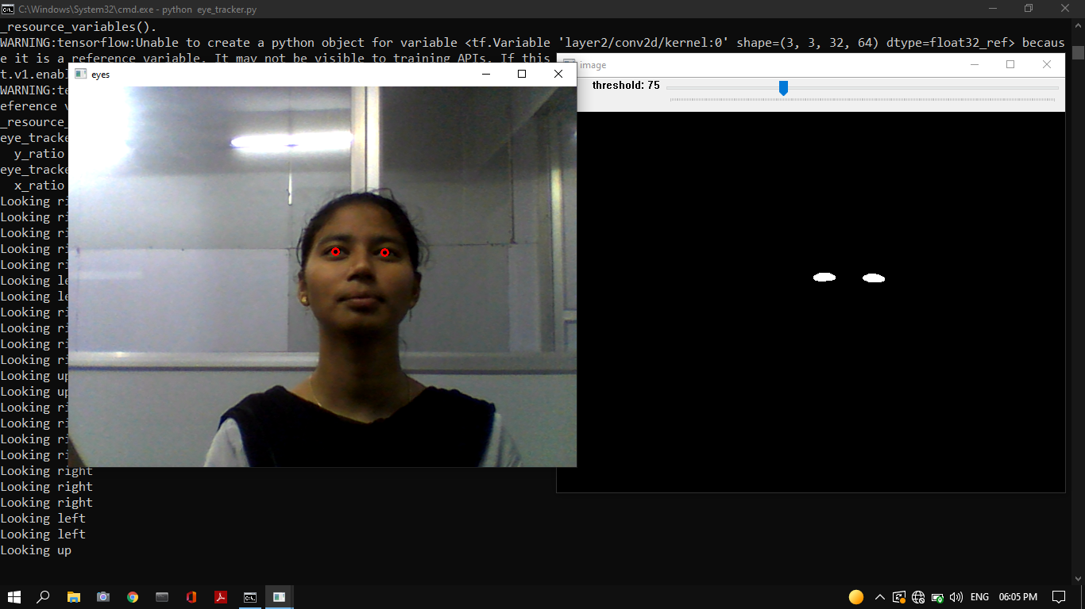

Output For Eye tracking
Binary Masking of eyeballs
Looking up Detected

Slide 14
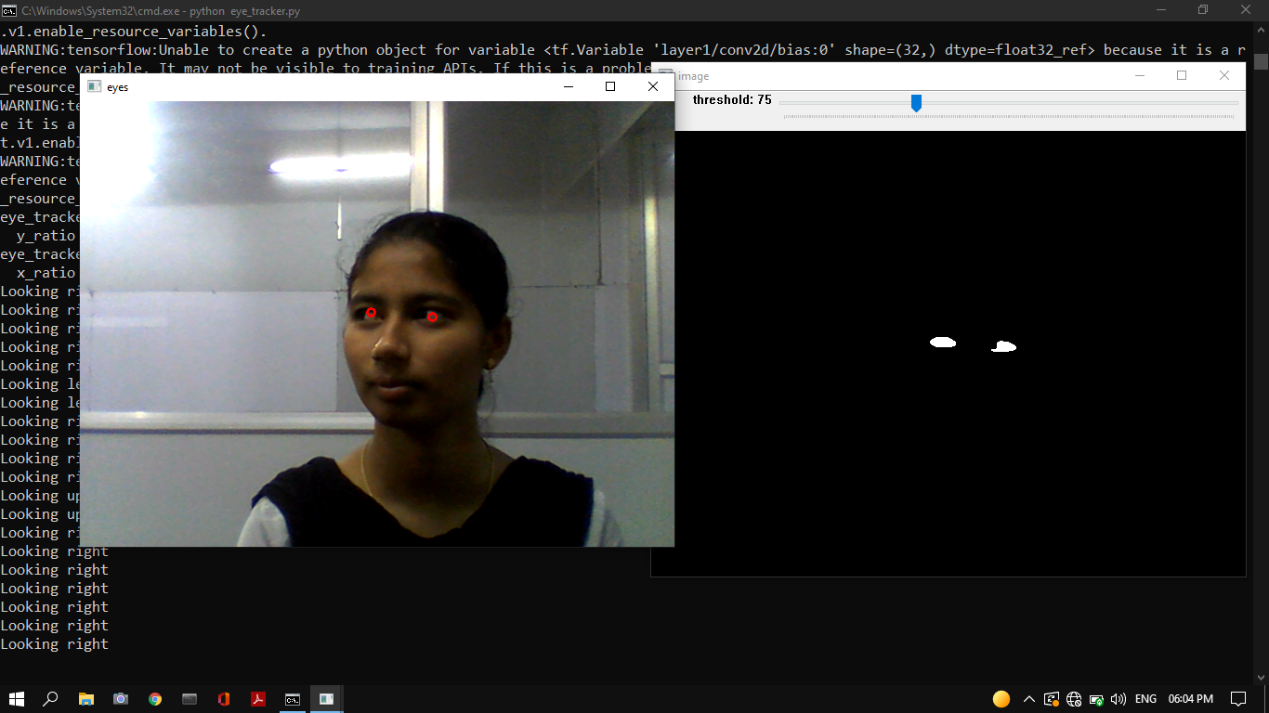
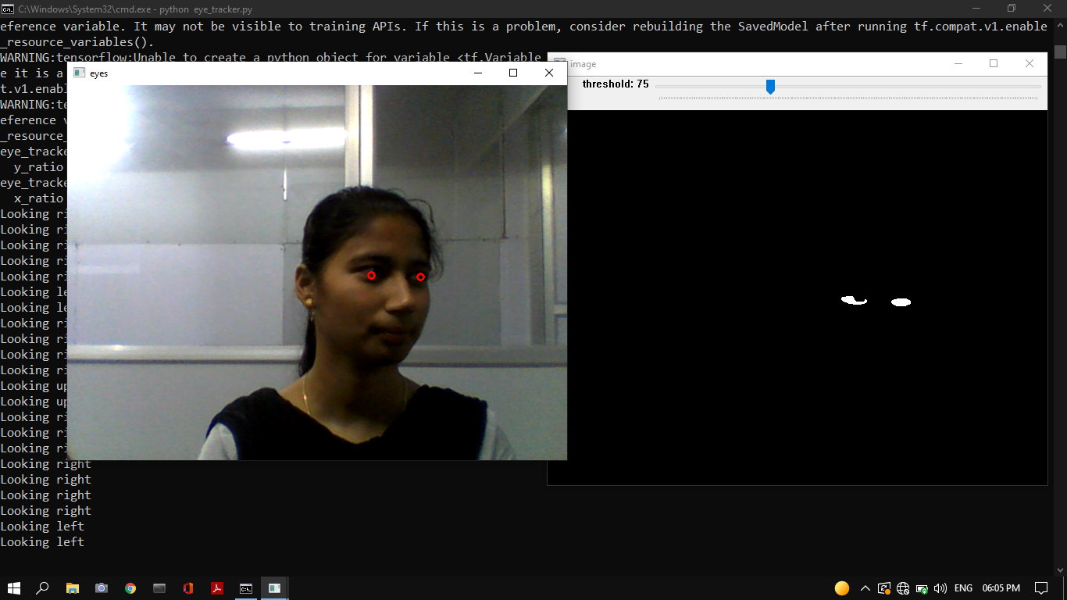
Output For Eye tracking
Looking Right Detected
Looking Left Detected

Slide 15
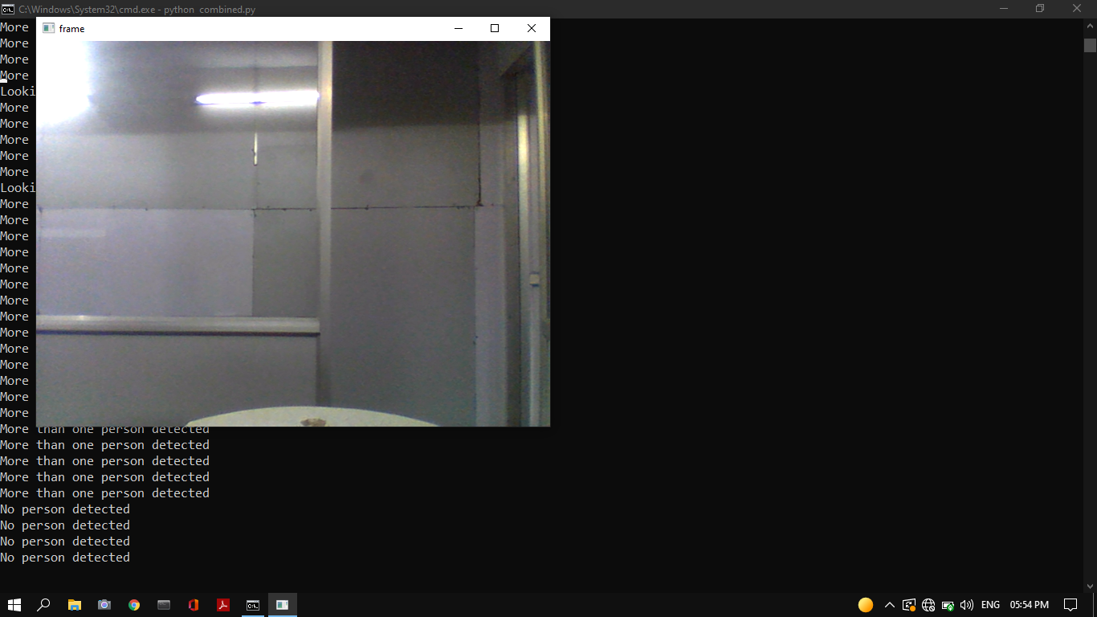
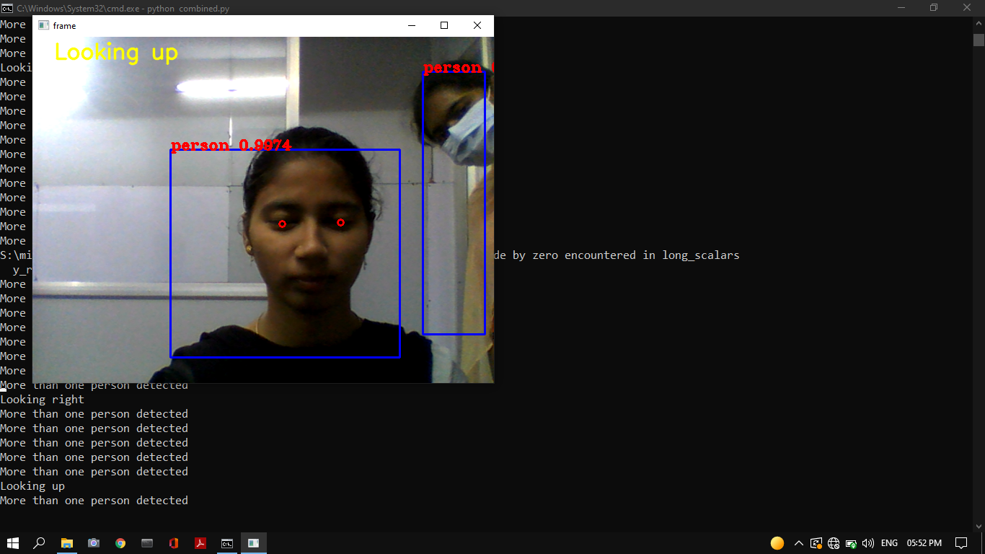
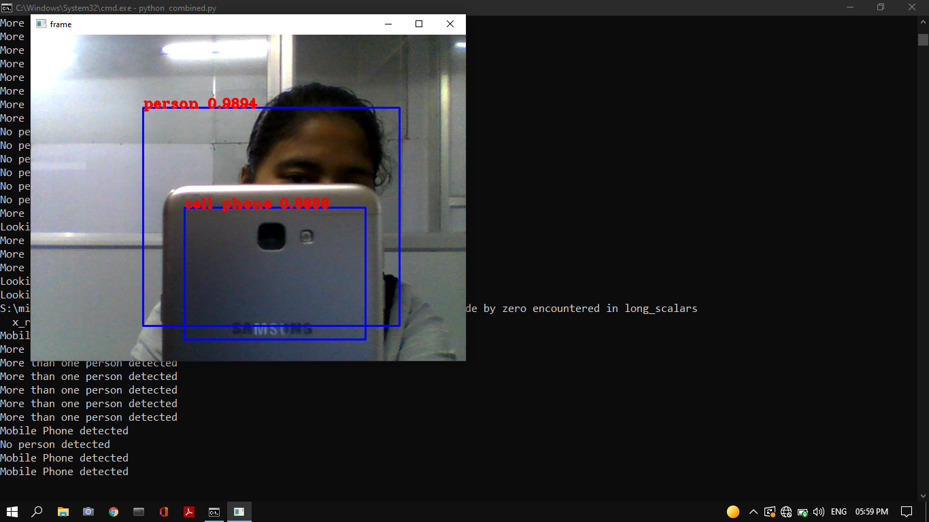
Output For Object Detection
No Person Detected
More than One Person Detected
Mobile Phone Detected

Slide 16
Reference
Zhang, Kaipeng & Zhang, Zhanpeng & Qiao, Yu. (2016). Joint Face Detection and Alignment Using Multitask Cascaded Convolutional Networks. IEEE Signal Processing Letters. 23. 10.1109/LSP.2016.2603342.
P. Adarsh, P. Rathi and M. Kumar, "YOLO v3-Tiny: Object Detection and Recognition using one stage improved model," 2020 6th International Conference on Advanced Computing and Communication Systems (ICACCS), 2020, pp. 687-694, doi: 10.1109/ICACCS48705.2020.9074315.
S. Kadambari, G. Prabhu, D. Mistry and M. Khanore, "Automation of Attendance System Using Facial Recognition," 2019 International Conference on Advances in Computing, Communication and Control (ICAC3), 2019, pp. 1-5, doi: 10.1109/ICAC347590.2019.9036819.
Cao, Qiong & Shen, Li & Xie, Weidi & Parkhi, Omkar & Zisserman, Andrew. (2018). VGGFace2: A Dataset for Recognising Faces across Pose and Age. 67-74. 10.1109/FG.2018.00020.

Slide 17
Thank you

